Slide 1

Do you believe that dual HER2 blockade combined with chemotherapy is the best strategy for neoadjuvant therapy in a patient with operable HER2-positive breast cancer?
Yes
No
Uncertain

Slide 2
Do you believe that dual HER2 blockade combined with chemotherapy is the best strategy for neoadjuvant therapy in a patient with operable HER2-positive breast cancer?
Yes
No
Uncertain
66.2%
15.8%
18%

Slide 3
Question #4:
Role of Combining Anti-HER Therapies in the Neoadjuvant Setting for HER2-Positive
Early Breast Cancer
Javier Cortés, MD, PhD
Vall d’Hebron University Hospital
Barcelona, Spain

Slide 4

Response to Neoadjuvant
Chemotherapy and Overall
Survival (OS) in Triple Negative
Breast Cancer (TNBC) and Non-TNBC
1
98%
P = .24
.9
94%
88%
.8
P = .0001
.7
68%
.6
pCR/nonTNBC
pCR/TNBC
RD/nonTNBC
RD/TNBC
.5
.4
1
2
3
4
5
6
7
Time After Surgery, years
Liedtke C, et al. J Clin Oncol. 2008;26(8):1275-1281.

Slide 5
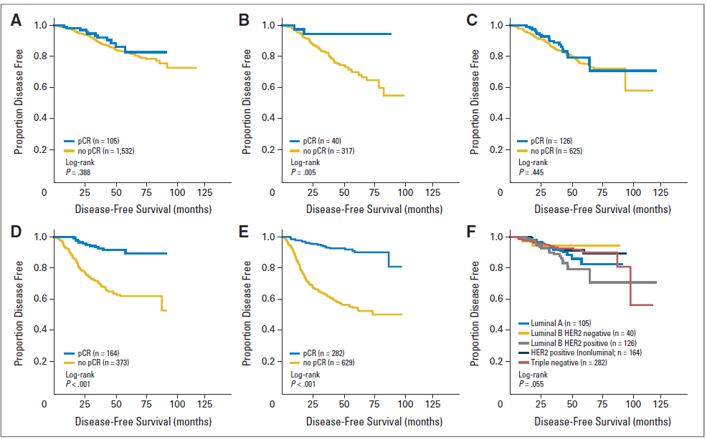
pCR and Prognosis by Subtype
(N = 4193)
Luminal A
Luminal B HER2-neg
Luminal B HER2-pos
HER2-pos (non-luminal)
TNBC
von Minckwitz G, et al. J Clin Oncol. 2012;30(15):1796-1804.

Slide 6
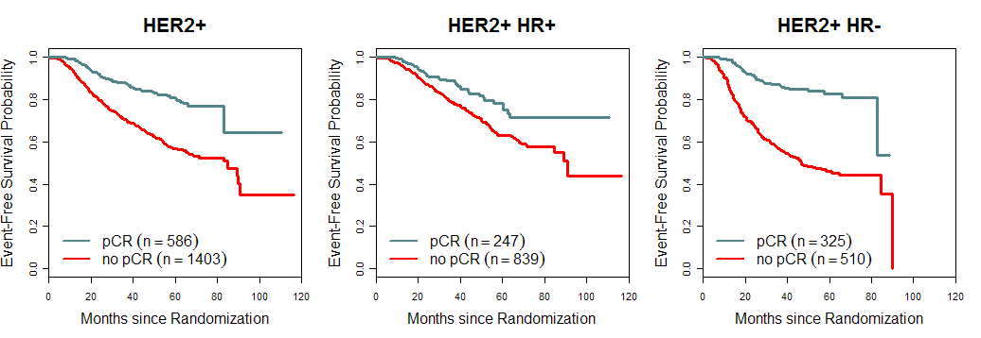
Association of pCR With EFS in HER2+ Subtype
HR = 0.39, P<.001
HR = 0.58, P = 0.001
HR = 0.25, P<.001
pCR = ypT0/is ypN0
Cortazar P, et al. Lancet. 2014;384(9938):164-172.

Slide 7
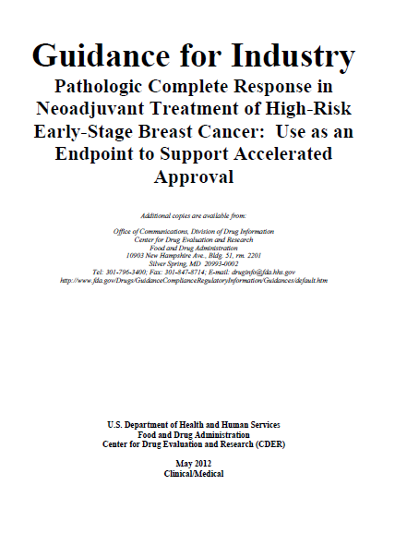

Slide 8
NeoALTTO Study Design
R
A
N
D
O
M
I
Z
E
Lapatinib
S
U
R
G
E
R
Y
F
E
C
X
3
Lapatinib
Eligibility
Invasive operable HER2+ breast cancer
Tumor >2 cm (inflammatory breast cancer excluded)
LVEF ≥50%
Stratification
Tumor ≤5 cm
vs Tumor >5 cm
ER or PgR+ vs ER and PgR-
N0-1 vs N≥2
Conservative surgery or not
Paclitaxel
Trastuzumab
Trastuzumab
Paclitaxel
Lapatinib
Lapatinib
Trastuzumab
Trastuzumab
Paclitaxel
6 weeks
+12 weeks
52 weeks of anti-HER2 therapy
LVEF, left ventricular ejection fraction
Baselga J, et al. Lancet. 2012;379(9816):633-640.

Slide 9
Study Objectives
Primary endpoint
  pCR: Defined according to the National Surgical Adjuvant Breast Project guidelines as no invasive cancer in the breast or only noninvasive in situ cancer in the breast specimen^{1,2}
Secondary endpoints
  pCR rate in breast AND lymph nodes [total pCR (tpCR)]
  Safety and tolerability
  Objective response rate at week 6 (end of biological
  window)
  Percentage of patients with node-negative disease at
  surgery
  Rate of conversion to breast-conserving surgery
  Rate of conversion to breast surgery in those with
  nonoperable disease at presentation
  Disease-free survival (DFS) and OS
1. Fisher B, et al. J Clin Oncol. 1997;15(7):2483-2493. 2. Fisher ER, et al. Cancer. 2002;95(4):681-695.
3. Baselga J, et al. Lancet. 2012;379(9816):633-640.

Slide 10
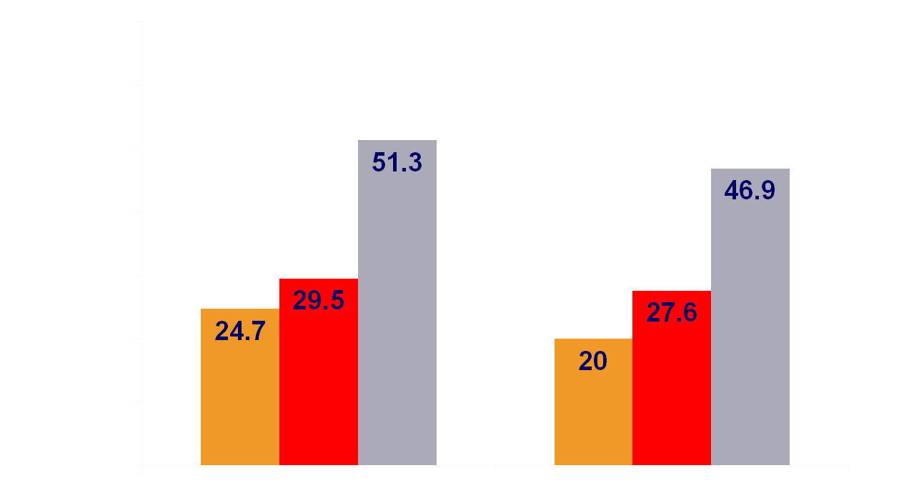
NeoALTTO: pCR and Total pCR
P = .0007
P = .0001
51.3
P = .13
46.8
P = .34
29.5
27.6
L
N = 154
T
N =149
L+T
N = 152
L
N = 150*
T
N = 145*
L+T
N = 145*
pCR
total pCR
*Excludes 15 patients with nonevaluable nodal status
L, lapatinib; T, trastuzumab
Baselga J, et al. Lancet. 2012;379(9816):633-640.
This agent may not be currently approved by the US Food and Drug Administration or European Medicines Agency for this indication.

Slide 11
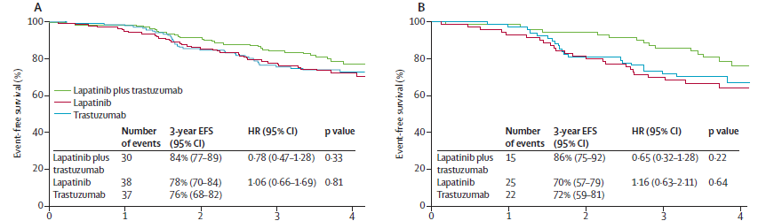
NeoALTTO: DFS
ER+
ER-
De Azambuja E, et al. Lancet Oncol. 2014;15(10):1137-1146.
This agent may not be currently approved by the US Food and Drug Administration or European Medicines Agency for this indication.

Slide 12


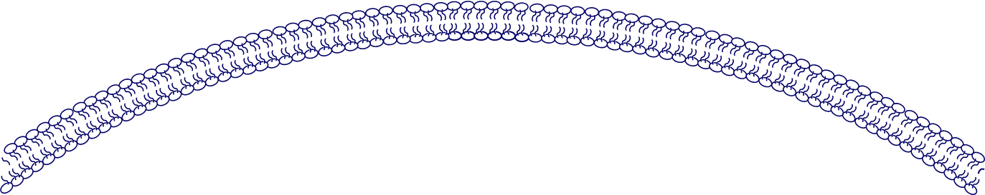
Rationale for Combining Pertuzumab With Trastuzumab in the Clinic: Pertuzumab and Trastuzumab Have Complementary Mechanisms of Action
Pertuzumab
HER2
HER1/3/4
Trastuzumab
Dimerization
domain
Subdomain IV
Trastuzumab:
Inhibits ligand-independent HER2 signaling
Activates ADCC
Prevents HER2 ECD shedding
Pertuzumab:
Inhibits ligand-dependent HER2 dimerization and signaling
Activates ADCC
ADCC, antibody-dependent cell-mediated cytotoxicity; ECD, extracellular domain
Molina MA, et al. Cancer Res. 2001;61(12):4744-4749. Junttila TT, et al. Cancer Cell. 2009;15(5):429-440. Agus DB, et al. Cancer Cell. 2002;2(2):127-137. Scheuer W, et al. Cancer Res. 2009;69(24) :9330-9336.

Slide 13
NeoSphere Study Design
TH (n = 107)
docetaxel +
trastuzumab
S
U
R
G
E
R
Y
FEC q3w x 3
Trastuzumab q3w cycles 5-17
Patients with operable or locally advanced/ inflammatory HER2-positive breast cancer
Chemo-naïve and primary tumors >2 cm
(N = 417)
THP (n = 107)
docetaxel +
trastuzumab +
pertuzumab
FEC q3 x 3
Trastuzumab q3w cycles 5-17
Docetaxel q3w x 4→FEC q3w x 3
Trastuzumab q3w cycles 5-17
HP (n = 107)
trastuzumab +
pertuzumab
TP (n = 96)
docetaxel +
pertuzumab
FEC q3w x 3
Trastuzumab q3w cycles 5-21
T, docetaxel; H, trastuzumab; FEC, 5-fluorouracil, epirubicin, and cyclophosphamide; P, pertuzumab
Gianni L, et al. Lancet Oncol. 2012;13(1):25-32.

Slide 14
NeoSphere Study Design
S
U
R
G
E
R
Y
FEC q3w x 3
Trastuzumab q3w cycles 5-17
Patients with operable or locally advanced/ inflammatory HER2-positive breast cancer
Chemo-naïve and primary tumors >2 cm
(N = 417)
THP (n = 107)
docetaxel +
trastuzumab +
pertuzumab
FEC q3 x 3
Trastuzumab q3w cycles 5-17
Docetaxel q3w x 4→FEC q3w x 3
Trastuzumab q3w cycles 5-17
FEC q3w x 3
Trastuzumab q3w cycles 5-21
Gianni L, et al. Lancet Oncol. 2012;13(1):25-32.

Slide 15
Study Objectives
Primary endpoint: Comparison of pCR rates
  TH vs THP
  Exploratory analyses
  TH vs HP
  THP vs TP
Secondary endpoints
  Clinical response
  DFS
  Breast conservation rate
  Biomarker evaluation
Gianni L, et al. Lancet Oncol. 2012;13(1):25-32.

Slide 16
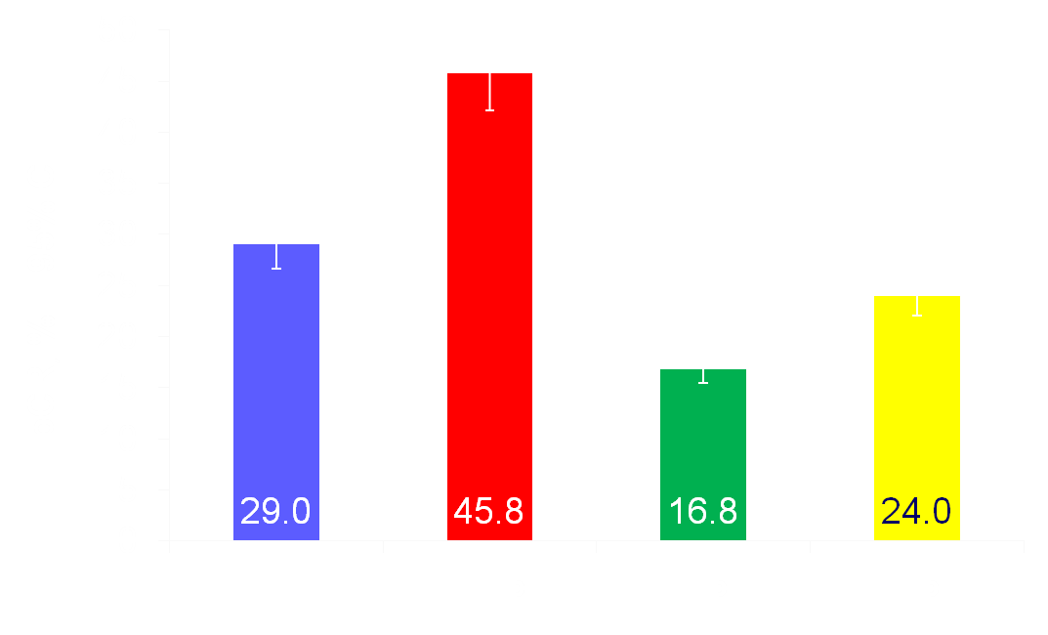
NeoSphere: pCR Rates
(Intention-to-Treat Population)
TH vs THP: P = .0141
THP vs TP: P = .003
TH vs HP: P = .0198
45.8
Gianni L, et al. Lancet Oncol. 2012;13(1):25-32.
This agent may not be currently approved by the US Food and Drug Administration or European Medicines Agency for this indication.

Slide 17
TRYPHAENA: Study Design
Cycles 1‒3
4‒6
A
FEC
Docetaxel
Pertuzumab + trastuzumab
S
u
r
g
e
r
y
HER2-positive
early breast cancer
centrally confirmed
(n = 225)
Trastuzumab
to complete
1 year
B
Docetaxel
FEC
Pertuzumab
+ trastuzumab
Docetaxel
C
Pertuzumab + trastuzumab
Carboplatin
Study dosing q3w
  FEC 500 mg/m², 100 mg/m², 600 mg/m²
  Carboplatin AUC 6
  Trastuzumab 8 mg/kg loading dose, 6 mg/kg maintenance
  Pertuzumab 840 mg loading dose, 420 mg maintenance
  Docetaxel 75 mg/m² (escalating to 100 mg/m² if tolerated, in arms A and B only)
AUC, area under the concentration-time curve
Schneeweiss A, et al. Ann Oncol. 2013;24(9):2278-2284.

Slide 18
TRYPHAENA: Cardiac Events During Neoadjuvant Treatment
 | FEC+H+P x3 → T+H+P x3 (n = 72) | FEC x3 → T+H+P x3 (n = 75) | TCH+P x6 (n = 76)
Symptomatic LVSD (grade ≥3), n (%) | 0 (0.0) | 2 (2.7) | 0 (0.0)
LVSD (all grades), n (%) | 4 (5.6) | 3 (4.0) | 2 (2.6)
LVEF decline ≥10% points and below 50%, n (%) | 3 (4.2) | 4 (5.3) | 3 (3.9)
Schneeweiss A, et al. Ann Oncol. 2013;24(9):2278-2284.
This agent may not be currently approved by the US Food and Drug Administration or European Medicines Agency for this indication.

Slide 19

TRYPHAENA: pCR
ypT0/is
ypT0 ypN0
66.2
61.6
57.3
50.7
51.9
Pathologic Complete Response, %
45.3
FEC+H+P x3
→ T+H+P x3
(n = 73)
FEC x3
→ T+H+P x3
(n = 75)
TCH+P x6
(n = 77)
Schneeweiss A, et al. Ann Oncol. 2013;24(9):2278-2284.
This agent may not be currently approved by the US Food and Drug Administration or European Medicines Agency for this indication.

Slide 20
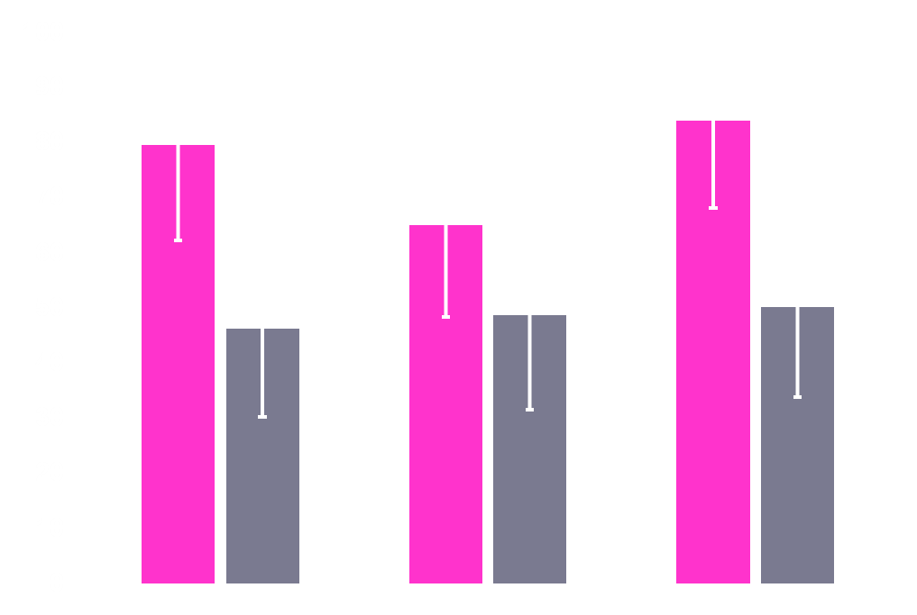
TRYPHAENA: pCR by Estrogen / Progesterone Receptor Status
ER- and PR-negative
ER- and/or PR-positive
ypT0/is
83.8
79.4
65.0
Pathologic Complete Response, %
48.6
50.0
46.2
FEC+H+P x3
→ T+H+P x3
(n = 73)
FEC x3
→ T+H+P x3
(n = 75)
TCH+P x6
(n = 77)
Schneeweiss A, et al. Ann Oncol. 2013;24(9):2278-2284.
This agent may not be currently approved by the US Food and Drug Administration or European Medicines Agency for this indication.

Slide 21
My Opinion
Do you believe that dual HER2 blockade combined with chemotherapy is the best strategy for neoadjuvant therapy in a patient with operable HER2-positive breast cancer?
Yes
No
Uncertain

